Slide 1
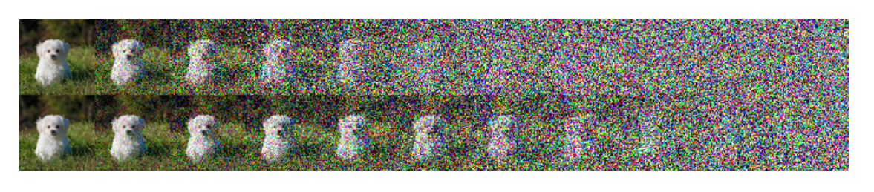
Diffusion Models
Linear Scheduler
Cosine Scheduler
Alex Nichol, Prafulla Dhariwal: Improved Denoising Diffusion Probabilistic Models, 2021

Slide 2
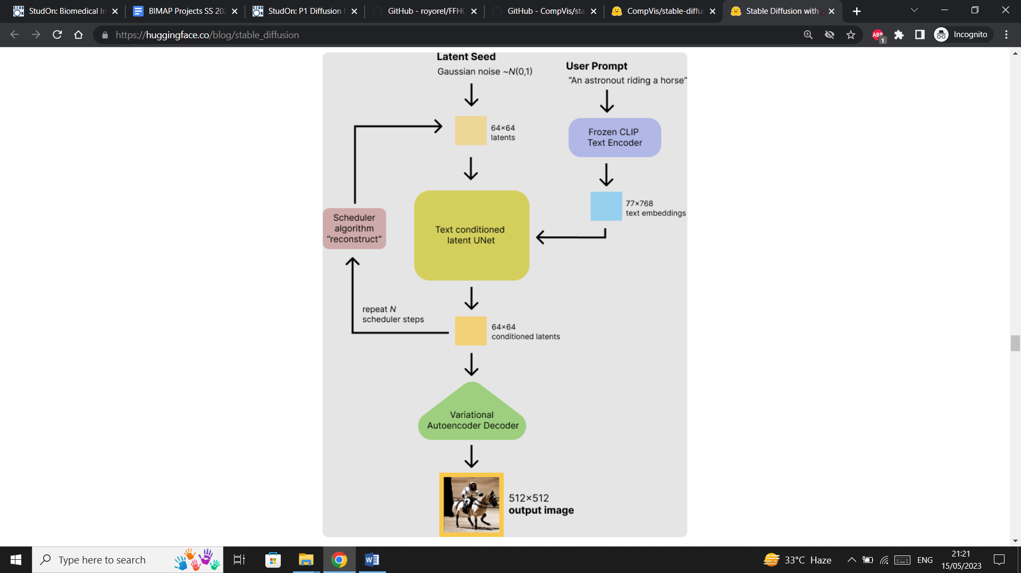

Slide 3
Our approach to the problem
As described by the professor
Try to run the pre-trained stable diffusion model
https://github.com/CompVis/stable-diffusion
Use the FFHQ aging dataset to fine-tune the model to produce artificially rejuvenated or aged faces
https://github.com/royorel/FFHQ-Aging-Dataset

Slide 4

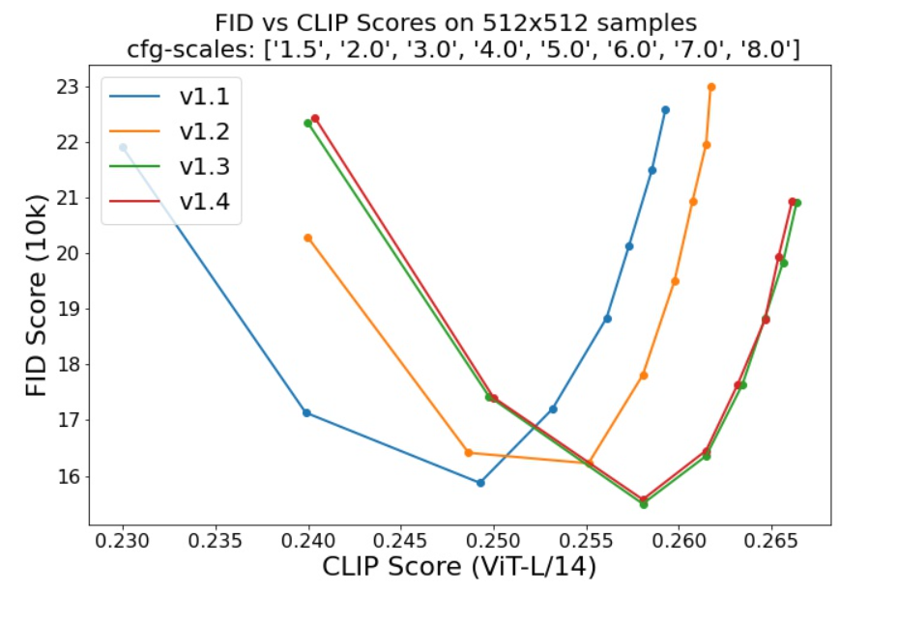
Platform and tools for building, training and deploying AI models.
Provides pre-trained models and pipelines.
The Hugging Face Diffuser’s library can be used to run our pre-trained stable diffusion model.

Slide 5
First interim meeting
Understanding diffusion models
Setting up the environment according to CompVis Github repo.
Performed inference – Cuda out of memory error
Inference worked on colab but no local file access – only through google drive
Read Hugging Face documentation for training and inference.

Slide 6
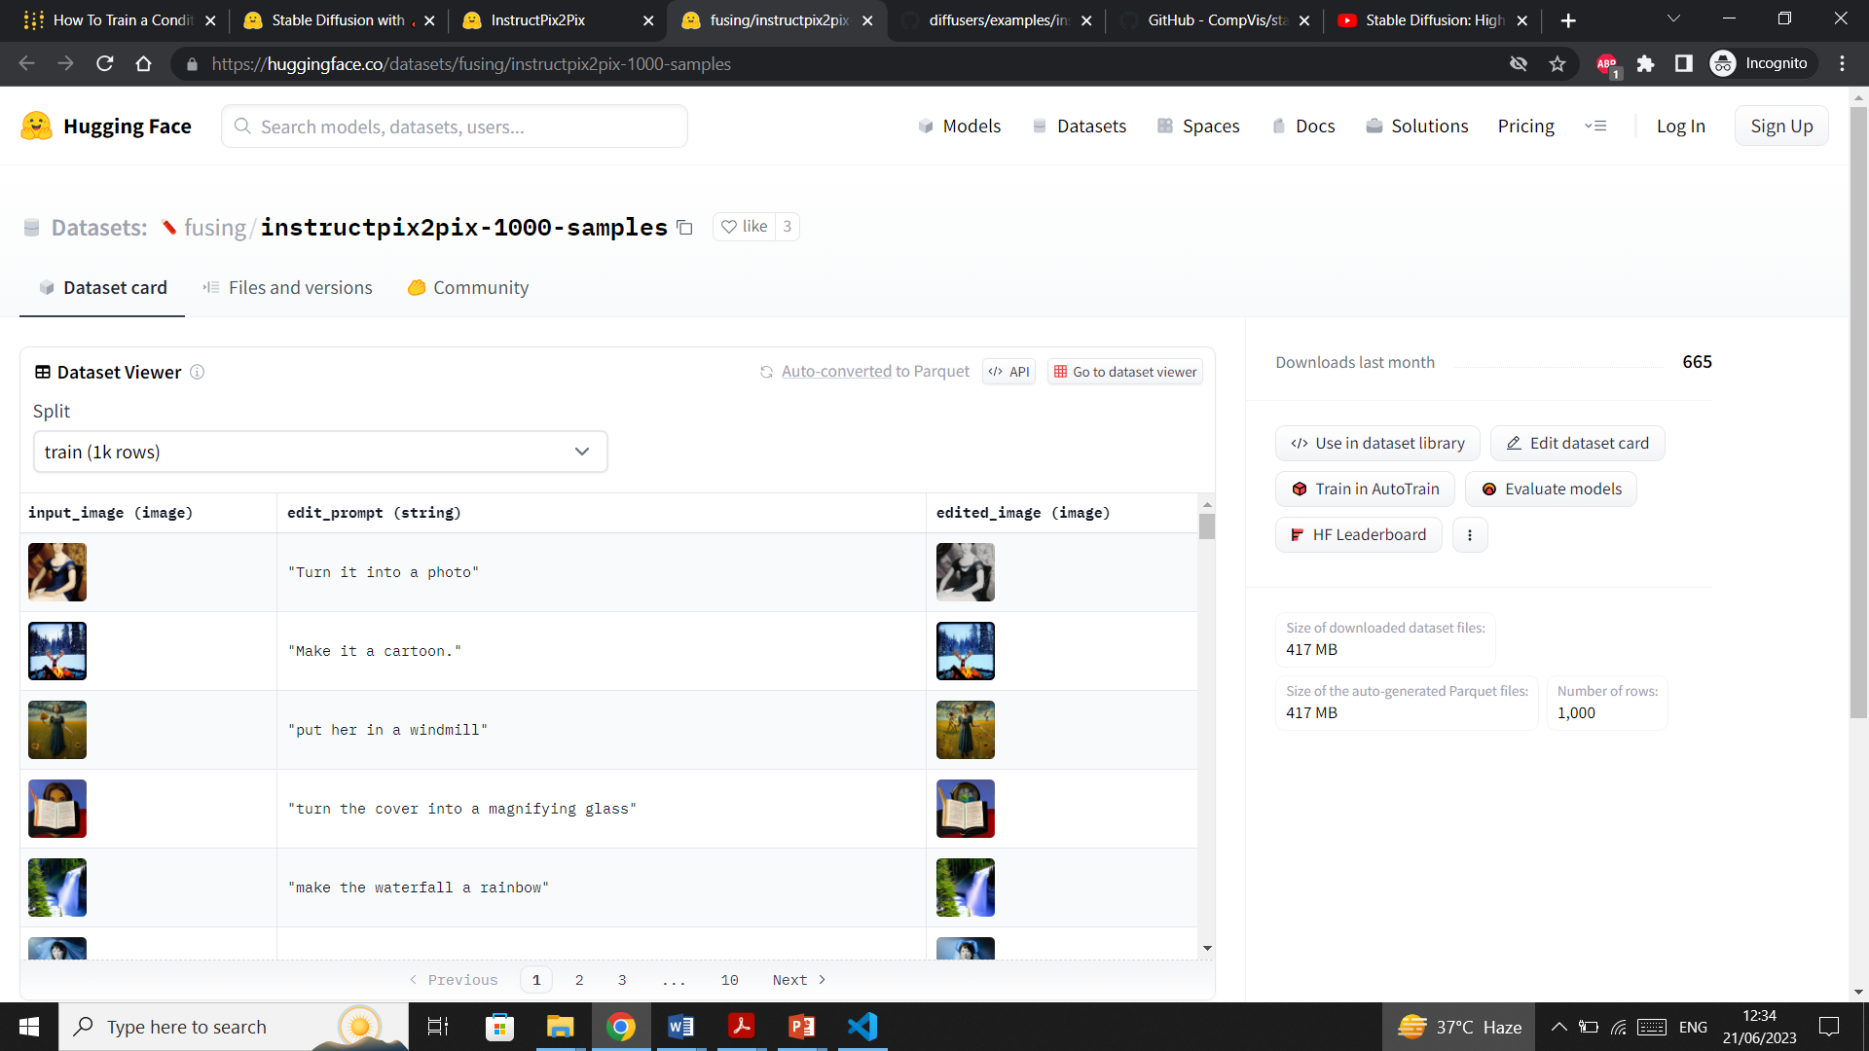
Training - InstructPix2Pix
InstructPix2Pix is a method to fine-tune text-conditioned diffusion models such that they can follow an edit instruction for an input image.
https://huggingface.co/docs/diffusers/training/instructpix2pix
Sample
Dataset

Slide 7
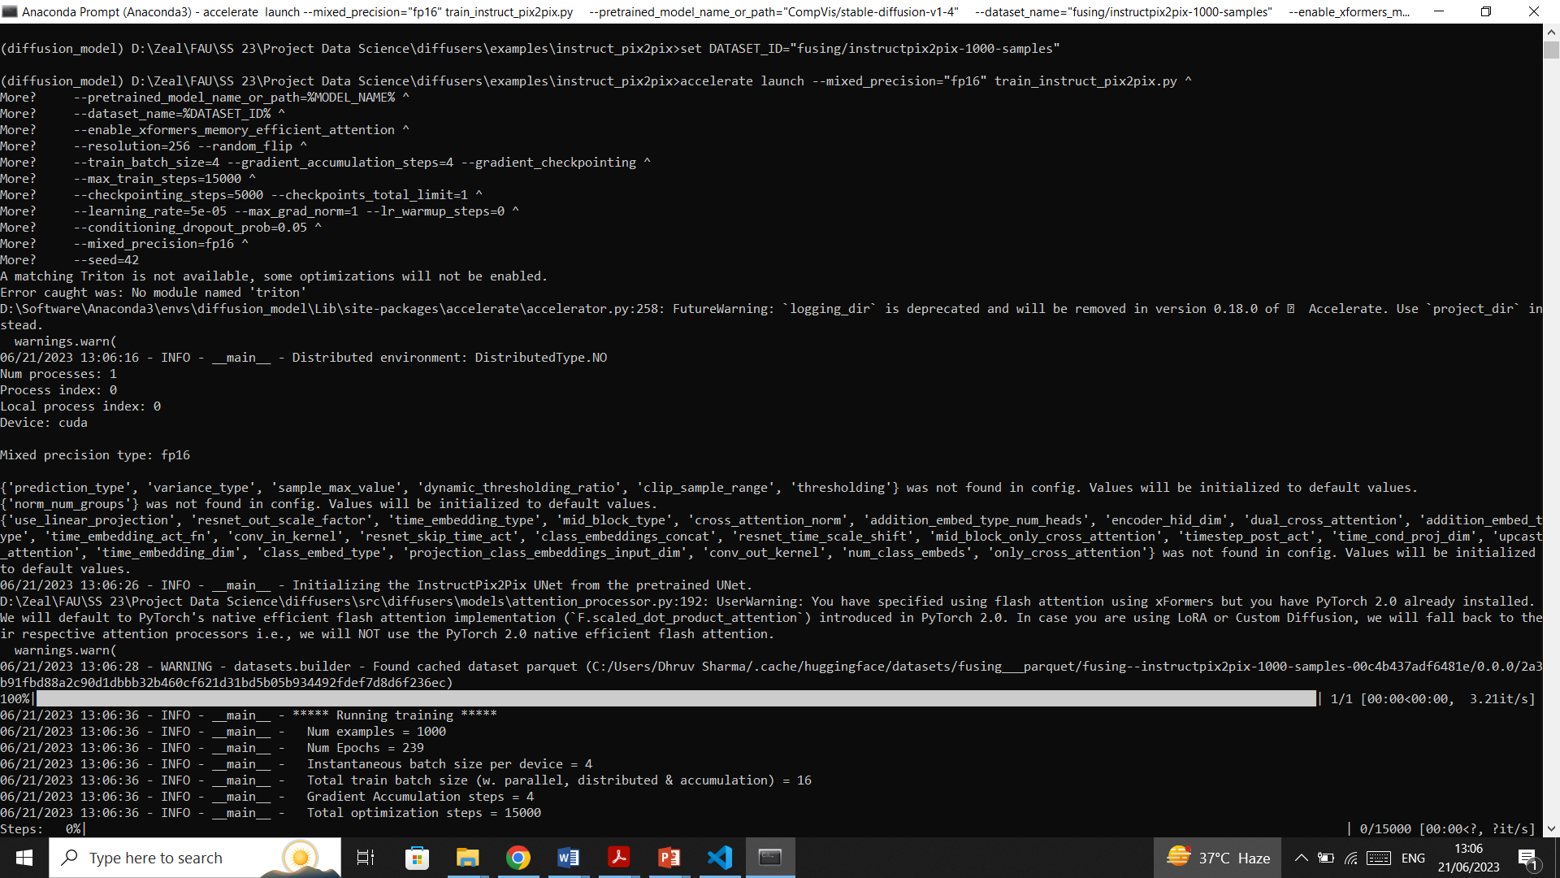
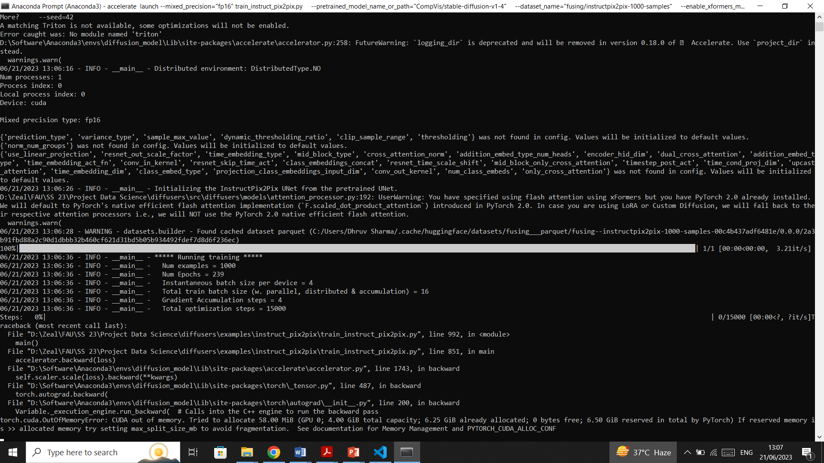

Slide 8
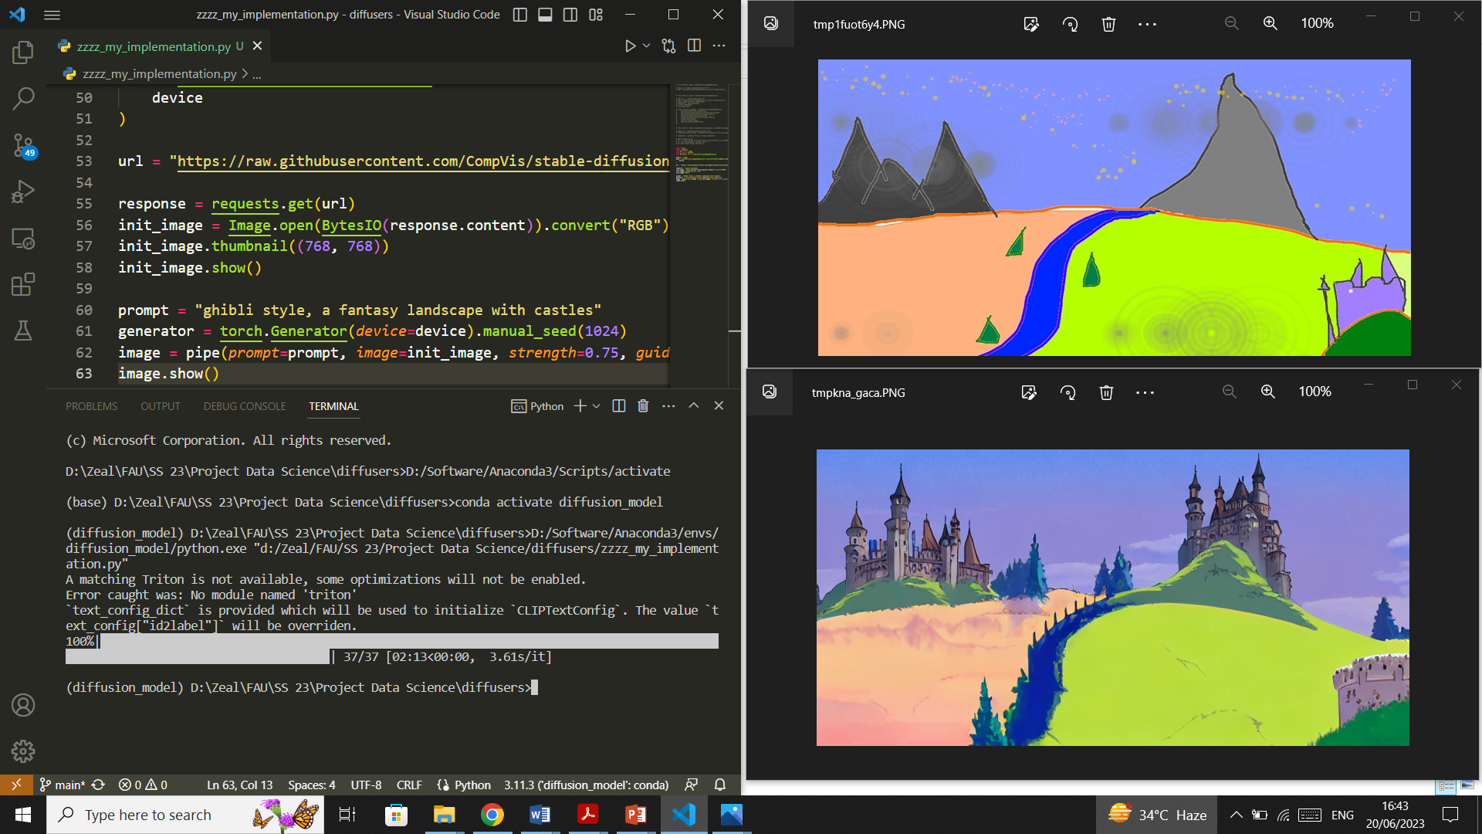
Inference

Slide 9
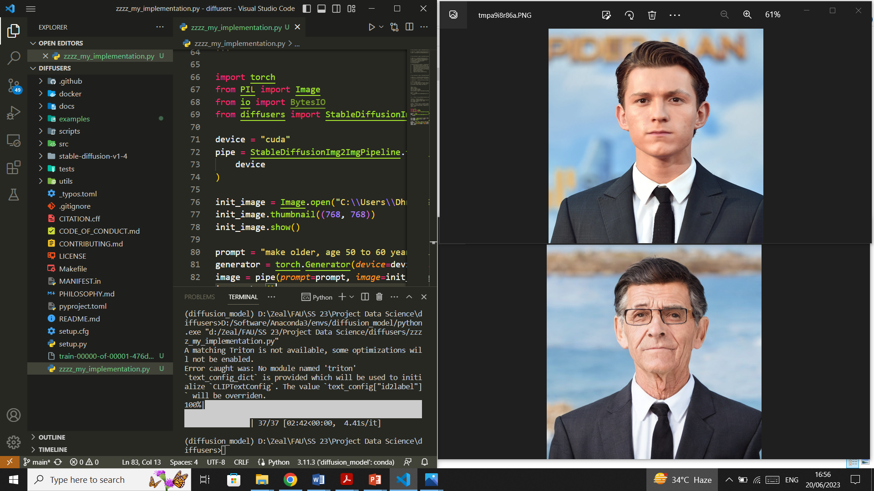

Slide 10
Second interim meeting
(Using Hugging Face library, before access to HPC)
No memory error for inference – probably more optimized
Trained sample dataset – Cuda out of memory error
Configured HPC
Linux environment required (triton module) – solved using HPC

Slide 11
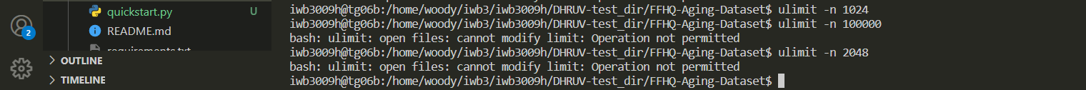
Dataset
Default method didn’t work, downloaded via PyDrive.
Script crashed every time after downloading 1024 images.
Changing max open files worked
Modified Dataset ✓, Sample training ✓, Inference pipeline ✓
Model trained successfully

Slide 12
Training Hyperparameters
Resolution - The resolution for input images, all the images in the train/validation dataset will be resized to this (default 256)
Random flip - whether to randomly flip images horizontally
Seed - A seed for reproducible training
lr_scheduler - The scheduler type to use. Choose between ["linear", "cosine", "cosine_with_restarts", "polynomial", "constant", "constant_with_warmup"]
Conditioning dropout probability - Drops out the conditionings (image and edit prompt) used in training InstructPix2Pix.
learning_rate - Initial learning rate (after the potential warmup period) to use
train_batch_size - Batch size (per device) for the training dataloader

Slide 13
Inference Parameters
image_guidance_scale
Image guidance scale is to push the generated image towards the inital image. Higher image guidance scale encourages to generate images that are closely linked to the source image image, usually at the expense of lower image quality.
guidance_scale
Higher guidance scale encourages to generate images that are closely linked to the text prompt, usually at the expense of lower image quality.
num_inference_steps
The number of denoising steps. More denoising steps usually lead to a higher quality image at the expense of slower inference.
negative_prompt
The prompt or prompts not to guide the image generation.

Slide 14


Prompt = "Make this male look 40-49 years old"

Slide 15
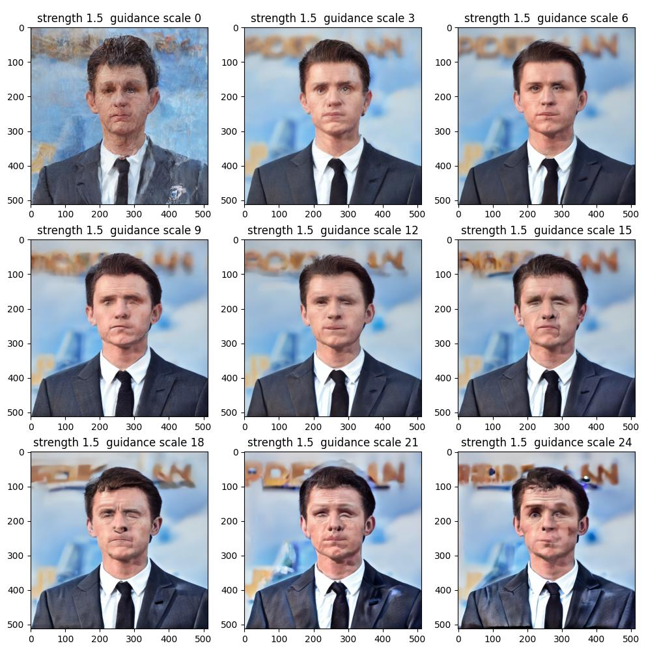
Varying
guidance_scale

Slide 16
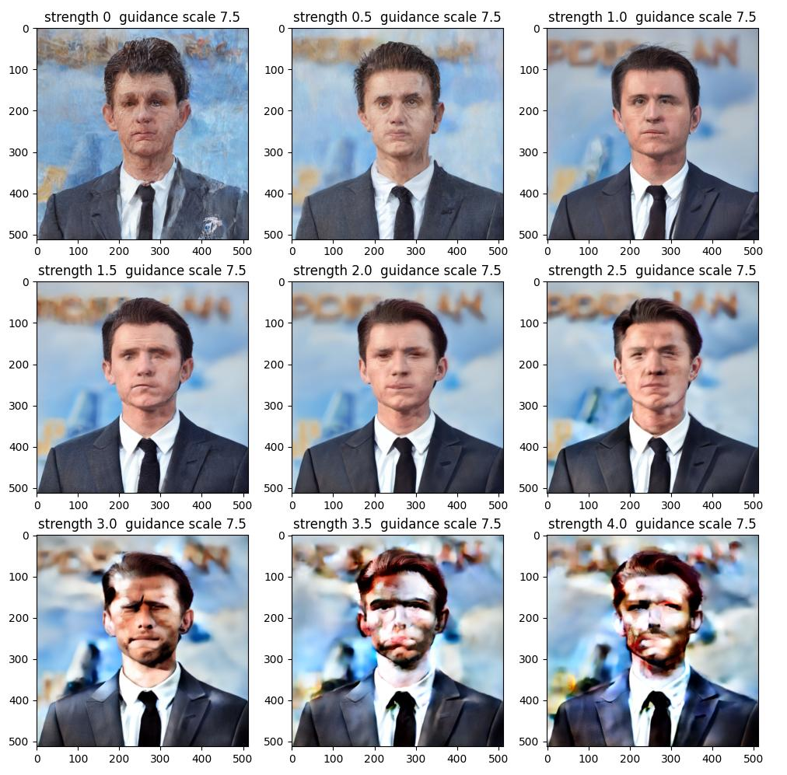
Varying
image_guidance_scale

Slide 17
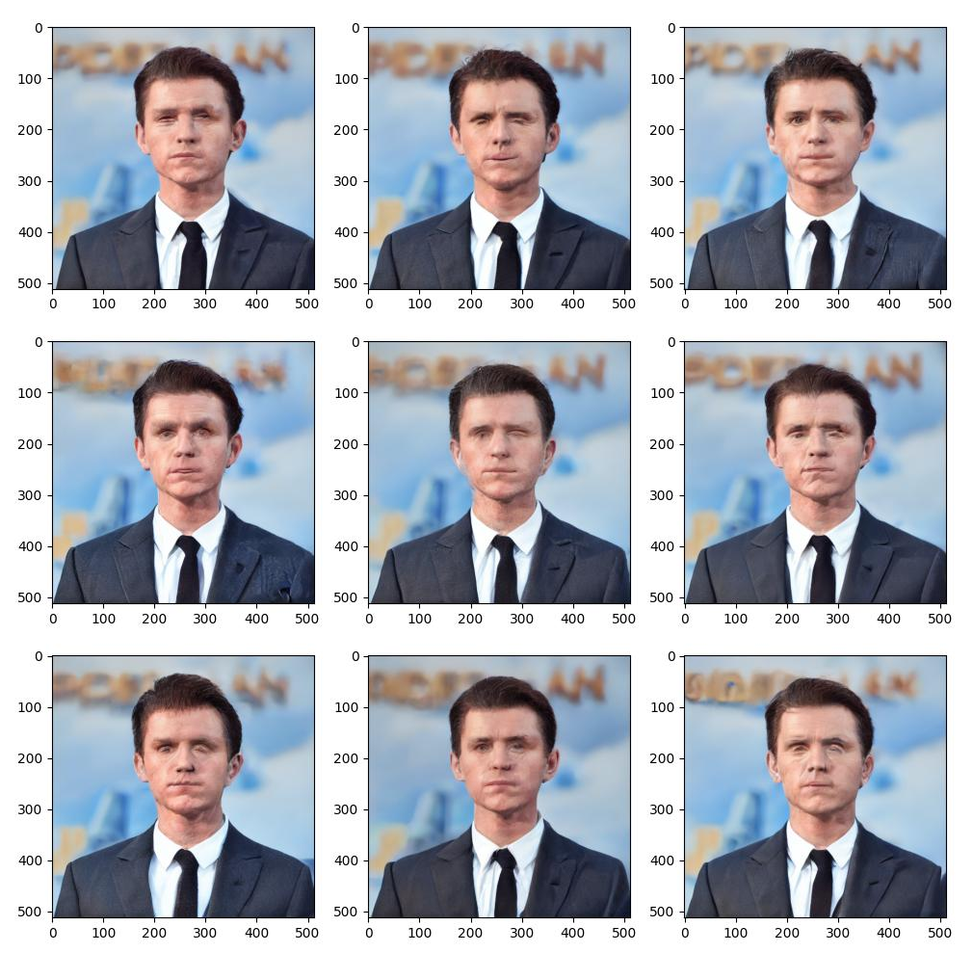
Our
Model

Slide 18
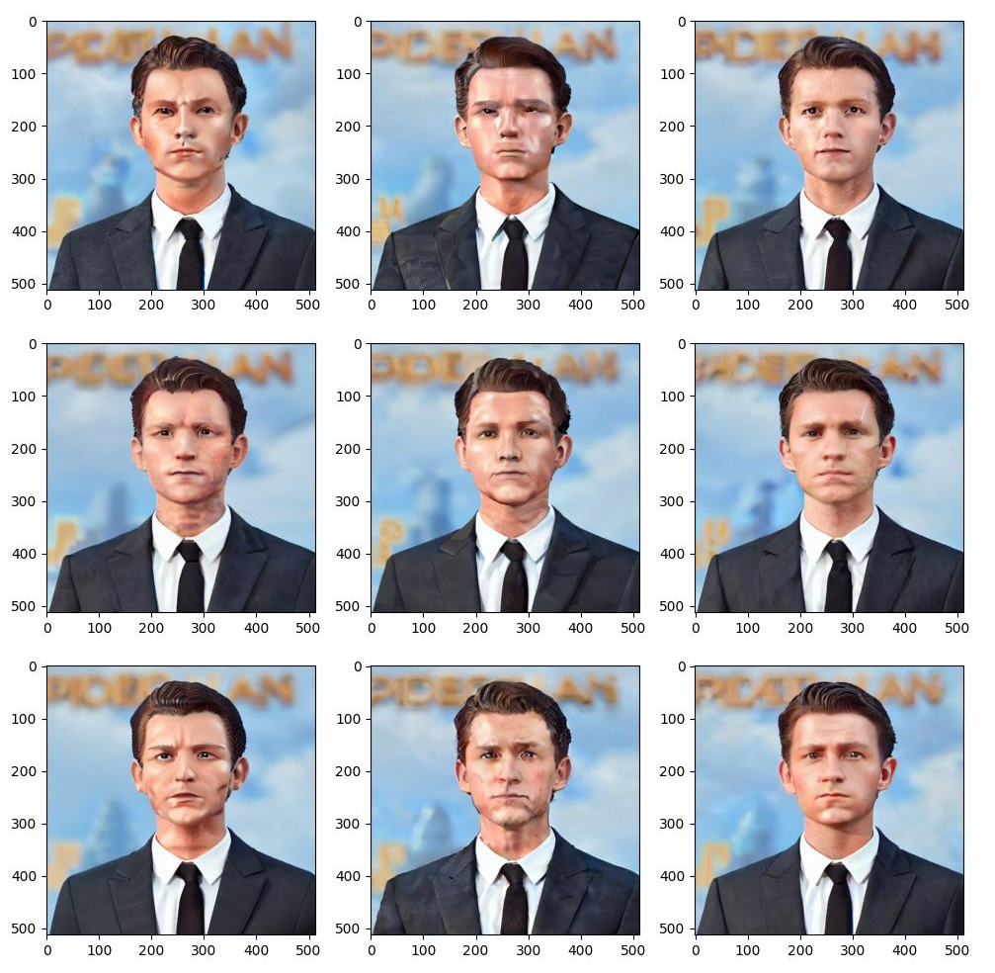
Pre-trained
Model

Slide 19
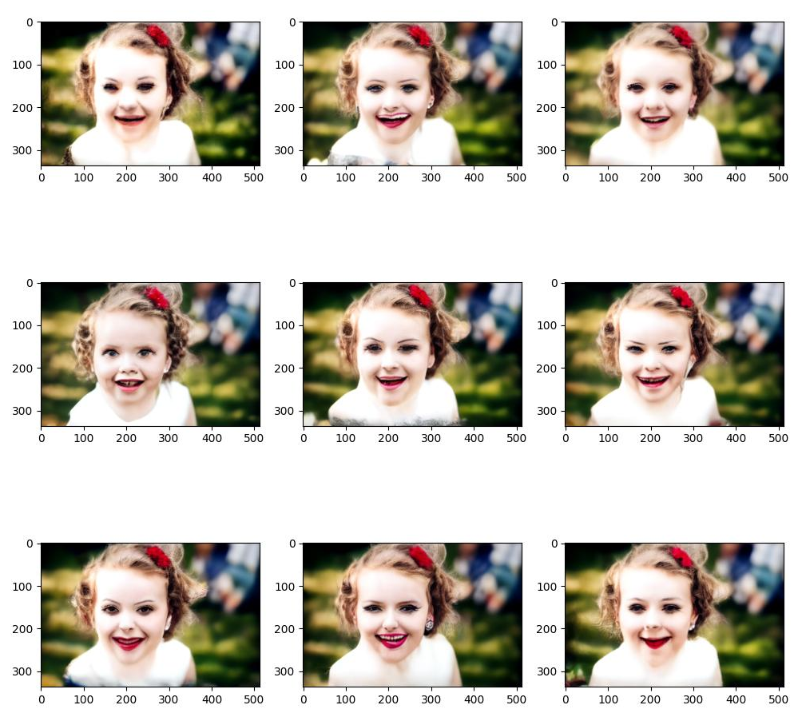
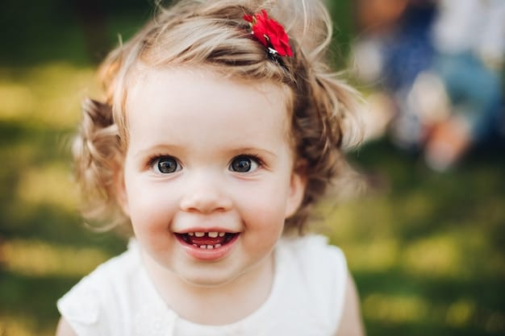
prompt =
"Make this female look 20-29 years old"

Slide 20
Denoising Process

